Slide 1
Managing your Honours project
Notes:
Delivered by Viv and Rose Ahlefeldt from Physics for Physics Honours students in 2020, for a 2hr workshop.
Physics Honours challenges involve delays in experiments, how to handle the scope of the project (e.g. may have ambitions for a very complex project, but the plans may not eventuate so need to identify exit points and stretch goals). Also how to handle the writing, and beginning writing early one.

Slide 2
Know your project
Reflect and be accountable
Define the project parameters
Break project into small, realistic milestones
Update your planners
Prioritise planning ahead
Be proactive with your supervisor
Notes:
KM: Outline for today’s workshop.

Slide 3

What makes time management difficult in Honours?
Notes:
KM: Ask students what time management challenges they foresee? Also ask how they anticipate managing some of these challenges?

Slide 4

Notes:
KM: What you should aim for is balance – to be able to achieve the things you need (succeed) whilst still doing the things that you enjoy.

Slide 5

Expectation
Accountability
Reality
Notes:
KM: There are expectations in place – our own and those of our lecturers/assessors – and we are often overly idealistic and ambitious about them (1), but reality is by no means neat and can sometimes work counter to our best intentions, which is a source of stress (2). It is important that our expectations and reality meet (3) and thus it is important that we find ways to be accountable (4).

Slide 6
Discuss in pairs
What helps you to stay accountable when meeting a deadline?
What strategies have you used in the past?
What do you think might work for your Honours project?
Notes:
KM: Get students to discuss at their tables. Afterwards debrief as a class
Examples:
Deadlines with your lab and your supervisor
Breaking down the dates for experiments
Checking in with friends

Slide 7
Reflect regularly
What is working?
What needs to change?
How are you managing stress?
How are you managing your life?
Notes:
KM: important to reflect on how you’re going, have an understanding of how you study best, and be aware of how you’re coping so that you can reach out for help when you need it

Slide 8
What are your major milestones?
What steps do you need to complete for each milestone?
Notes:
KM: Ask students what their major milestones are, and the steps they need to take to reach those milestones?

Slide 9
Realistic research goals
Skim through the research proposal
In pairs, consider its feasibility
What is the scope of the project?
Do you think the proposed project is achievable in the allocated time?
Where could difficulties arise?
Which goals would you choose as essential and which could be stretch goals?
Notes:
Handout Matt Goh’s original proposal – note that Matt Goh was a University Medallist.

Slide 10
Realistic research outcomes
Now skim through the post-Honours commentary
In pairs, discuss
What was and was not achieved?
Did the achievements match what you anticipated what could/couldn't be achieved?
How did he deal with the challenges?
How stressful does the project sound and how could you plan to alleviate such stressors?
Notes:
Matt’s commentary shows he was only able to achieve roughly 2/3 of what he planned. The fact he won a Uni Medal shows it’s not only about having a great project, it’s also about how you manage the challenges and then communicate the achievements of your project in your thesis. This also shows the value of identifying early on which goals are realistic and which ones are ambitious (the ‘if time’ or ‘stretch’ goals).

Slide 11
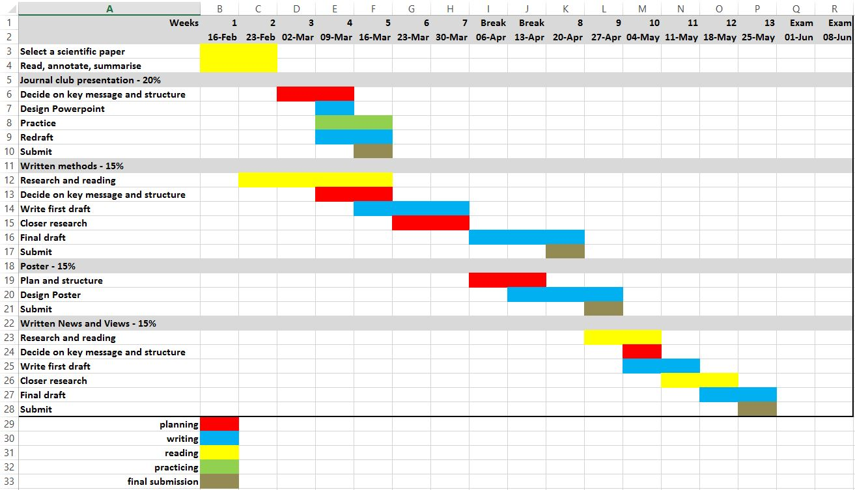
Notes:
KM: Encourage students to complete a Gantt chart like this, breaking down and colour coding their tasks over the course of the year

Slide 12
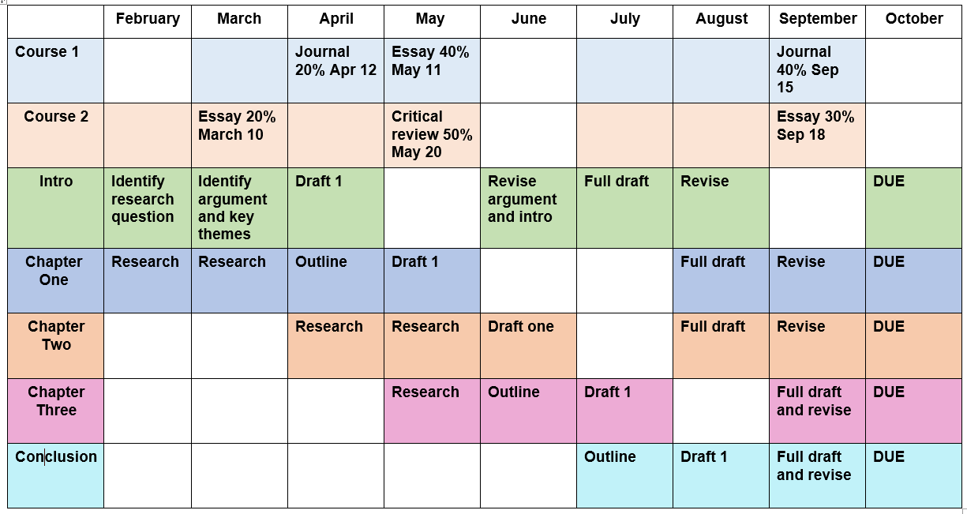
Bigger picture planning: break down your tasks
Notes:
Message: use a planner to work out what tasks for the semester/year and how much time to allocate in order to complete.

Slide 13
Activity
Jot down your research tasks and their constraints, e.g.
Experiments
What do you need to do?
Are your experiments dependent on other factors? E.g. training, access to equipment, data from other experiments?
Thesis writing
Which parts can you write as you go? E.g. intro and methods
When could you begin to anticipate your results and discussion points?

Slide 14
Discuss in pairs
Given the constraints, how long do you think each of your tasks will take?
Which of your goals are essential and which are stretch goals?

Slide 15
 | Monday | Tuesday | Wednesday | Thursday | Friday | Saturday | Sunday
8:00 AM |  | HOBBY |  |  |  | FUN STUFF | FUN STUFF
8:30 AM
9:00 AM |  |  |  |  | EXPERIMENTS
9:30 AM
10:00 AM | EXPERIMENTS | EXPERIMENTS | THESIS WRITING | EXPERIMENTS
10:30 AM |  |  |  |  |  | WORK
11:00 AM
11:30 AM |  |  |  |  |  |  | THESIS WRITING/ BUFFER
12:00 PM |  |  | EXPERIMENTS
12:30 PM
1:00 PM | THESIS WRITING |  |  | THESIS WRITING
1:30 PM
2:00 PM
2:30 PM |  |  |  |  |  |  | FUN STUFF
3:00 PM | THESIS RESEARCH | THESIS RESEARCH
3:30 PM
4:00 PM
4:30 PM
5:00 PM |  |  | THESIS RESEARCH | EXPERIMENTS
5:30 PM |  | FUN STUFF
6:00 PM |  |  |  |  | FUN STUFF/ BUFFER | FUN STUFF/ BUFFER | THESIS RESEARCH / BUFFER
6:30 PM
7:00 PM |  | THESIS RESEARCH | HOBBY
7:30 PM
8:00 PM | THESIS RESEARCH |  |  | THESIS RESEARCH
8:30 PM
Notes:
KM: Talk about the value of mapping out one’s week using a weekly planner. Circulate around room and if time permits get students to fill one out…
On habit-building, from Caroline Leaf’s Switch on Your Brain
It takes 21 days of deep thinking for a thought to become long-term memory
It takes two more 21-day cycles (another 42 days) for a habit to form and solidify
These thoughts/habits can be positive/ constructive or negative/destructive
Re: the initial 21 day cycle, use driving to work or uni as an example; after three weeks, it becomes automated
Re: the full 63 day cycle, use eating healthy as an example. You can give up sugar or most things for 21 days, but it takes 63 days to solidify the break. Likewise, it takes time to develop both good and bad habits; you don’t want to let bad habits crystallise, and you also want to ensure good habits are maintained…

Slide 16
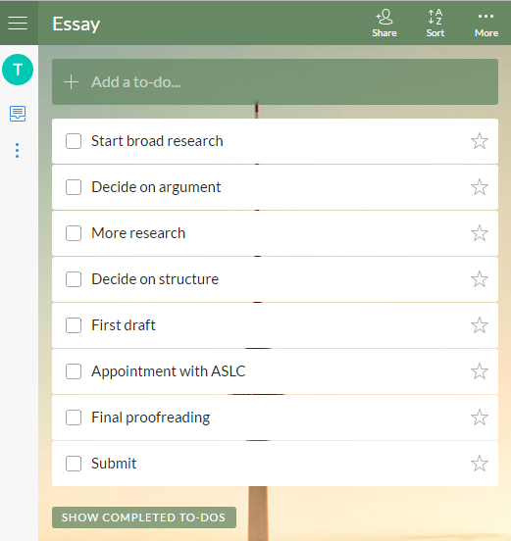
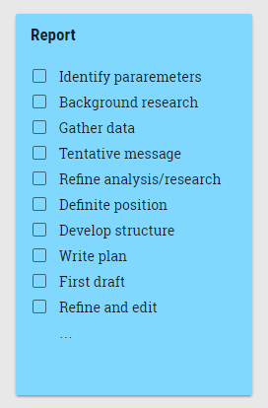
To-do lists
Tool | Description
Wunderlist | A simple list application for making a quick to-do list that you can access on multiple devices
Evernote | Also a list application but includes lots of other tools such as notetaking. Has a free and a paid version
Google Keep | Works like post-it notes that you can colour code. Simple, free and effective
Trello | A more serious project management tool that allows you to share lists with others and allocate tasks across a group
Notes:
KM: Then talk about the value of to-do lists. Flag that these should be used in conjunction with the semester and weekly planner: look what needs to be done each week and break down into smaller tasks, then designate windows of opportunity each week for doing those things. Ask is students have used any of these tools. Enquire what others tools they may have used

Slide 17
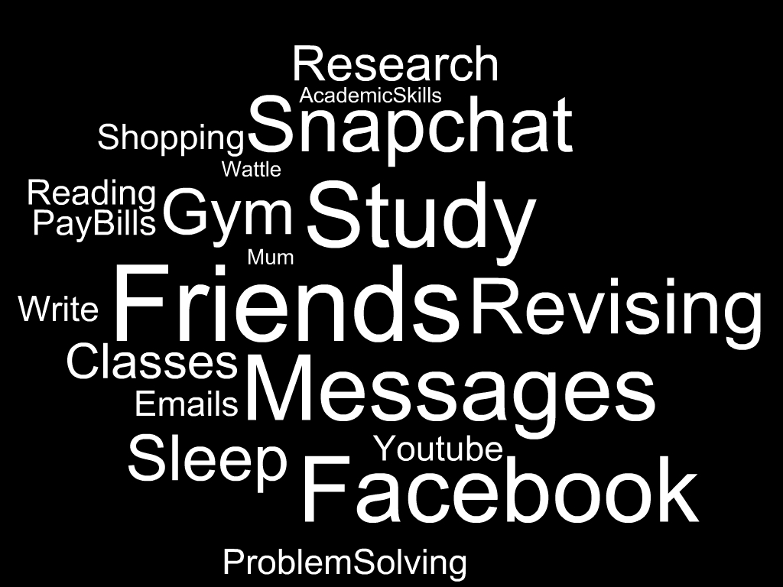
How do you work out what to prioritise?
Experiments
Seminars
Workshops
Notes:
KM: We all have a lot going on in our lives. We need to work out what is most important so that wecan prioritise. Sometimes it can be hard to distinguish what is important when there is no much going on and so many distractions

Slide 18

Covey’s Quadrants
Urgent
Not Urgent
I
II
Important
III
IV
Not Important
Notes:
KM: Introduce Covey’s quadrants as a way of working out what is important so that they can prioritise

Slide 19
Activity
Consider your current activities.
Which ones fall into which quadrants?
Urgent
Not Urgent
I
II
Important
III
IV
Not Important
Notes:
KM: Important to identify that whilst things can seem important, they may not be. Focussing on the unimportant leads to more things becoming urgent.
In groups, think about all the things a student might do from day to day. Which quadrant do they fall into? What is urgent? What is important? Can something be urgent but not important?

Slide 20
Urgent
Not Urgent
I
II
Crises
Deadlines
Planning
Organising
Important
Quadrant of Necessity
Quadrant of Quality
III
IV
Interruptions
Messages
Trivia
Time wasters
Not Important
Quadrant of Deception
Quadrant of Waste
Notes:
KM: Ask students where their activities landed. Discuss and debrief as a class. Note that some activities evolve over time: a bill due in a month is important but not urgent, but becomes urgent and important if left too late.
So many activities that we think are urgent and important are not! If you focus too much on the not important, things will end up in quadrant 1
Quadrant of deception: Emails, messages, even some phone calls can feel urgent but on further reflection, they’re not.
Other points:
Time spent in III and IV tends to lead to more activities becoming crises (quadrant I) – refer back to the earlier point about leaving things to the last minute
Time spent organising and planning can save time in the long run as you prioritise, set objectives and goals and work out how to complete tasks successfully.

Slide 21
Working with your supervisor(s)
Notes:
KM: It is an important relationship but it is one that needs to be nurtured by both parties. Note it can also be a shift in “relationship status”: you go from being a student to a colleague...

Slide 22
Scenarios
Review the scenarios
How could you respond to these situations?
How could you prevent these situations?
Notes:
KM: Ask students to review the scenarios in groups. Debrief as a class afterwards, discussing each one

Slide 23
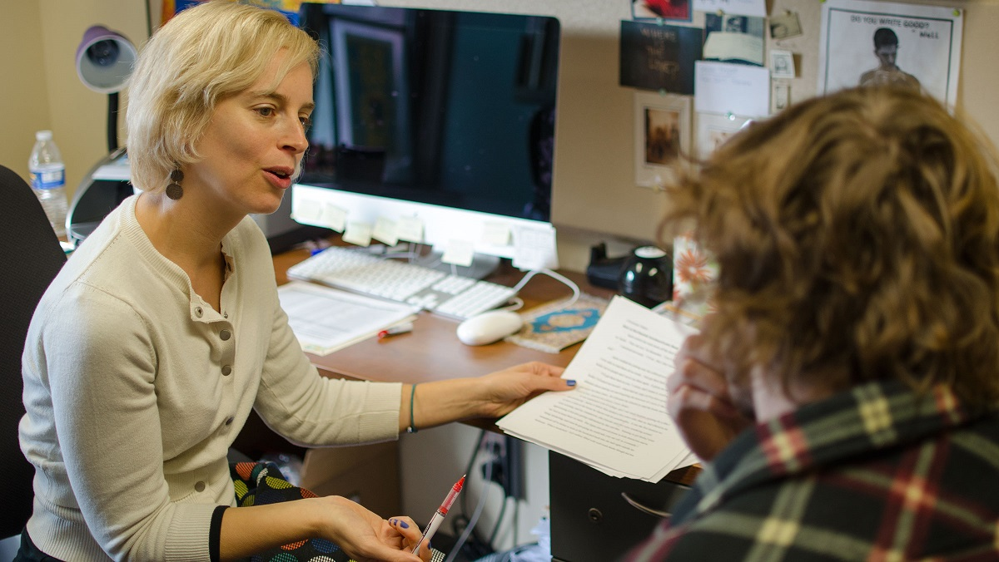
Tips for working with your supervisor(s)
Clear expectations
Set them early
Meet regularly
Constant communication
Pre-meeting agenda
Meeting minutes/summary
Deal with feedback
Notes:
KM: Elaborate on above

Slide 24

How can you improve your writing?
Start writing early
Keep writing
Keep reading
Keep a vocabulary notebook
Seek feedback
Supervisor
Academic Skills
Draft and re-draft
Notes:
KM: Writing is a big part of Honours, and it might not be an area you’re comfortable with. Here are some tips…

Slide 25
Know your project
Reflect and be accountable
Define the project parameters
Break project into small, realistic milestones
Update your planner
Prioritise planning ahead
Be proactive with your supervisor
Notes:
KM: Also important to know your project. Recap of what we’ve covered.

Slide 26
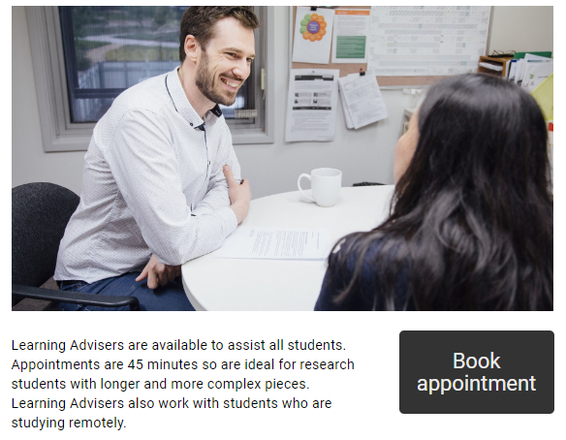
Academic Skills
1-1 appointments for advice on your writing
anu.edu.au/academicskills
Research writing web resources

